Slide 1
AI-Powered Collections Strategy
Leveraging Agentic AI for Scalable, Fair, and Effective Debt Management at Geldium

Slide 2
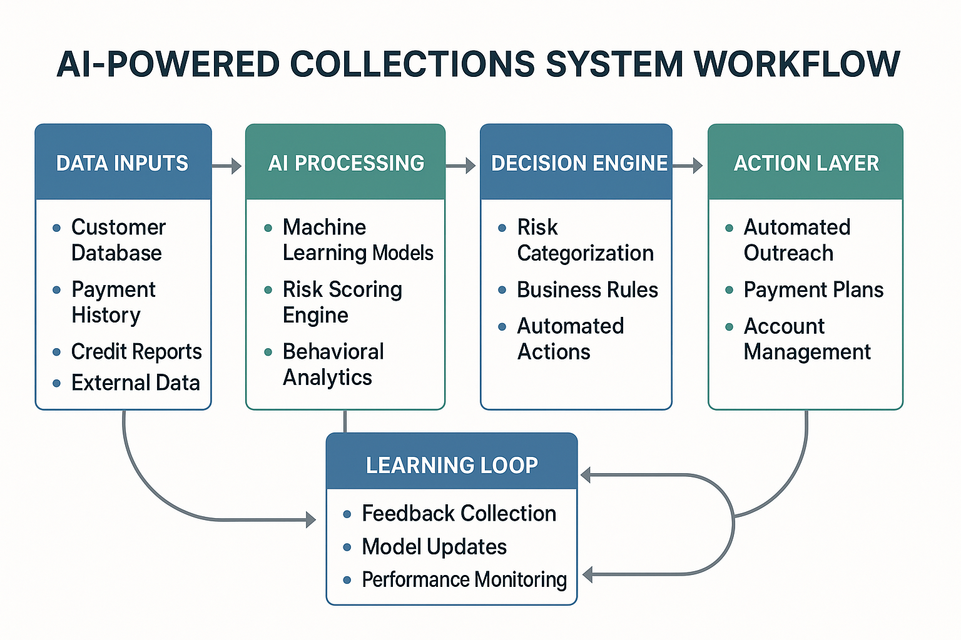
How the AI-Powered Collections System Works
The AI-powered collections system operates as an intelligent, autonomous decision-making platform that processes customer data in real-time to predict delinquency risk and trigger appropriate interventions

Slide 3
4 -Part System Workflow:
1. Data Inputs & Processing
Customer Database: Demographics, account history, payment patterns
Real-time Transaction Data: Payment behaviors, account activity
External Data Sources: Credit bureau reports, employment verification
Historical Performance: 6-month payment tracking (On-time/Late/Missed patterns)
2. AI Decision Logic
Ensemble Model: Random Forest (70%) + Logistic Regression (30%)
Risk Scoring: 0-100 scale with key thresholds at 30 (Medium) and 70 (High)
Feature Analysis: Income Level (10.6%), Credit Score (9.8%), Payment History (9.5%)
Segment-specific Rules: Business cards (21.3% risk), Unemployed customers (19.4% risk)
3. Automated Actions
Low Risk (0-30): Standard monitoring, automated payment reminders
Medium Risk (30-70): Enhanced monitoring, personalized outreach, payment plan offers
High Risk (70-100): Immediate intervention, human escalation, intensive support
4. Continuous Learning Loop
Feedback Collection: Customer response tracking, payment outcomes
Model Updates: Monthly retraining with new data, performance optimization
Performance Monitoring: Real-time dashboard tracking, bias detection

Slide 4
Role of Agentic AI : Autonomous vs. Human-in-the-Loop Task Allocation
Task Type | Autonomous AI | Human Oversight | Automation Level
Low-risk Customer Outreach | ✅ Automated emails, SMS reminders | ❌ Not required | 90%
Payment Reminders | ✅ Personalized messaging, scheduling | ❌ Not required | 85%
Account Status Updates | ✅ Real-time processing, notifications | ❌ Not required | 80%
Medium-risk Case Management | ⚠️ AI-generated recommendations | ✅ Human review and approval | 50%
High-risk Interventions | ⚠️ Risk alerts, suggested actions | ✅ Human-led strategy | 30%
Legal Escalation | ⚠️ Case preparation, documentation | ✅ Human decision-making | 10%
Complex Negotiations | ❌ AI support only | ✅ Human expertise required | 5%
Policy Decisions | ❌ Data insights only | ✅ Human judgment essential | 0%

Slide 5
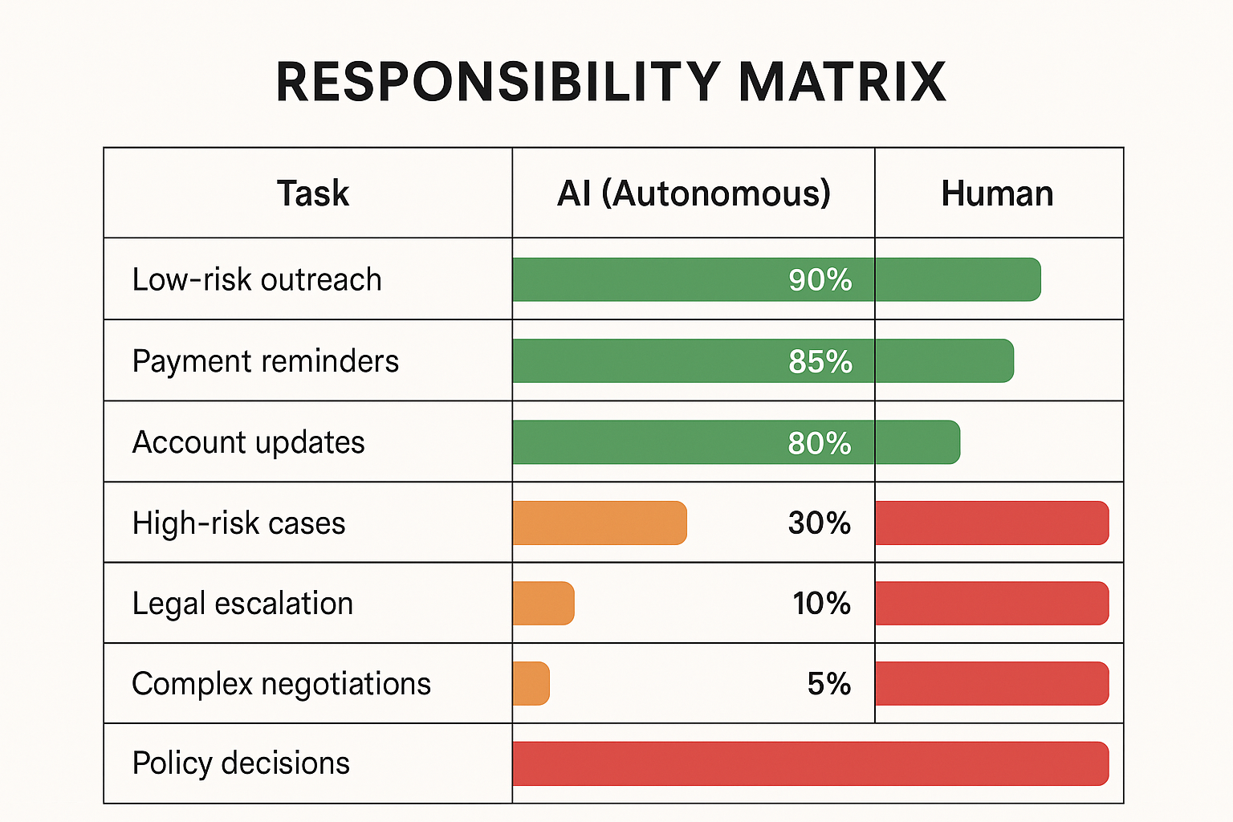
Key Benefits of Agentic AI: 78% Overall Automation Rate: Handles routine cases autonomously 24/7 Operations: Continuous monitoring and immediate response Consistency: Standardized decision-making across all cases Scalability: Processes thousands of accounts simultaneously

Slide 6
Comprehensive Responsible AI Framework
1. Fairness & Bias Mitigation
Demographic Parity: Equal treatment across age, location, employment status
Equalized Odds: Consistent true/false positive rates across protected groups
Regular Audits: Monthly bias detection, quarterly fairness assessments
Threshold Optimization: Risk-adjusted decision boundaries by segment
2. Explainability & Transparency
Clear Decision Logic: Customers receive plain-language explanations
Feature Importance: Transparent ranking of risk factors
Appeals Process: Human review mechanism for contested decisions
Audit Trail: Complete decision history and reasoning documentation
3. Privacy & Data Protection
Data Minimization: Only necessary data collected and processed
Encryption: End-to-end security for all customer information
Compliance: GDPR, CCPA, and financial regulation adherence
Anonymization: Customer data protected during model training
4. Continuous Monitoring & Governance
Real-time Performance: Dashboard tracking for model drift
Ethical Review Board: Quarterly assessments of AI decisions
Customer Feedback: Direct input mechanism for system improvements
Regulatory Reporting: Transparent compliance documentation

Slide 7
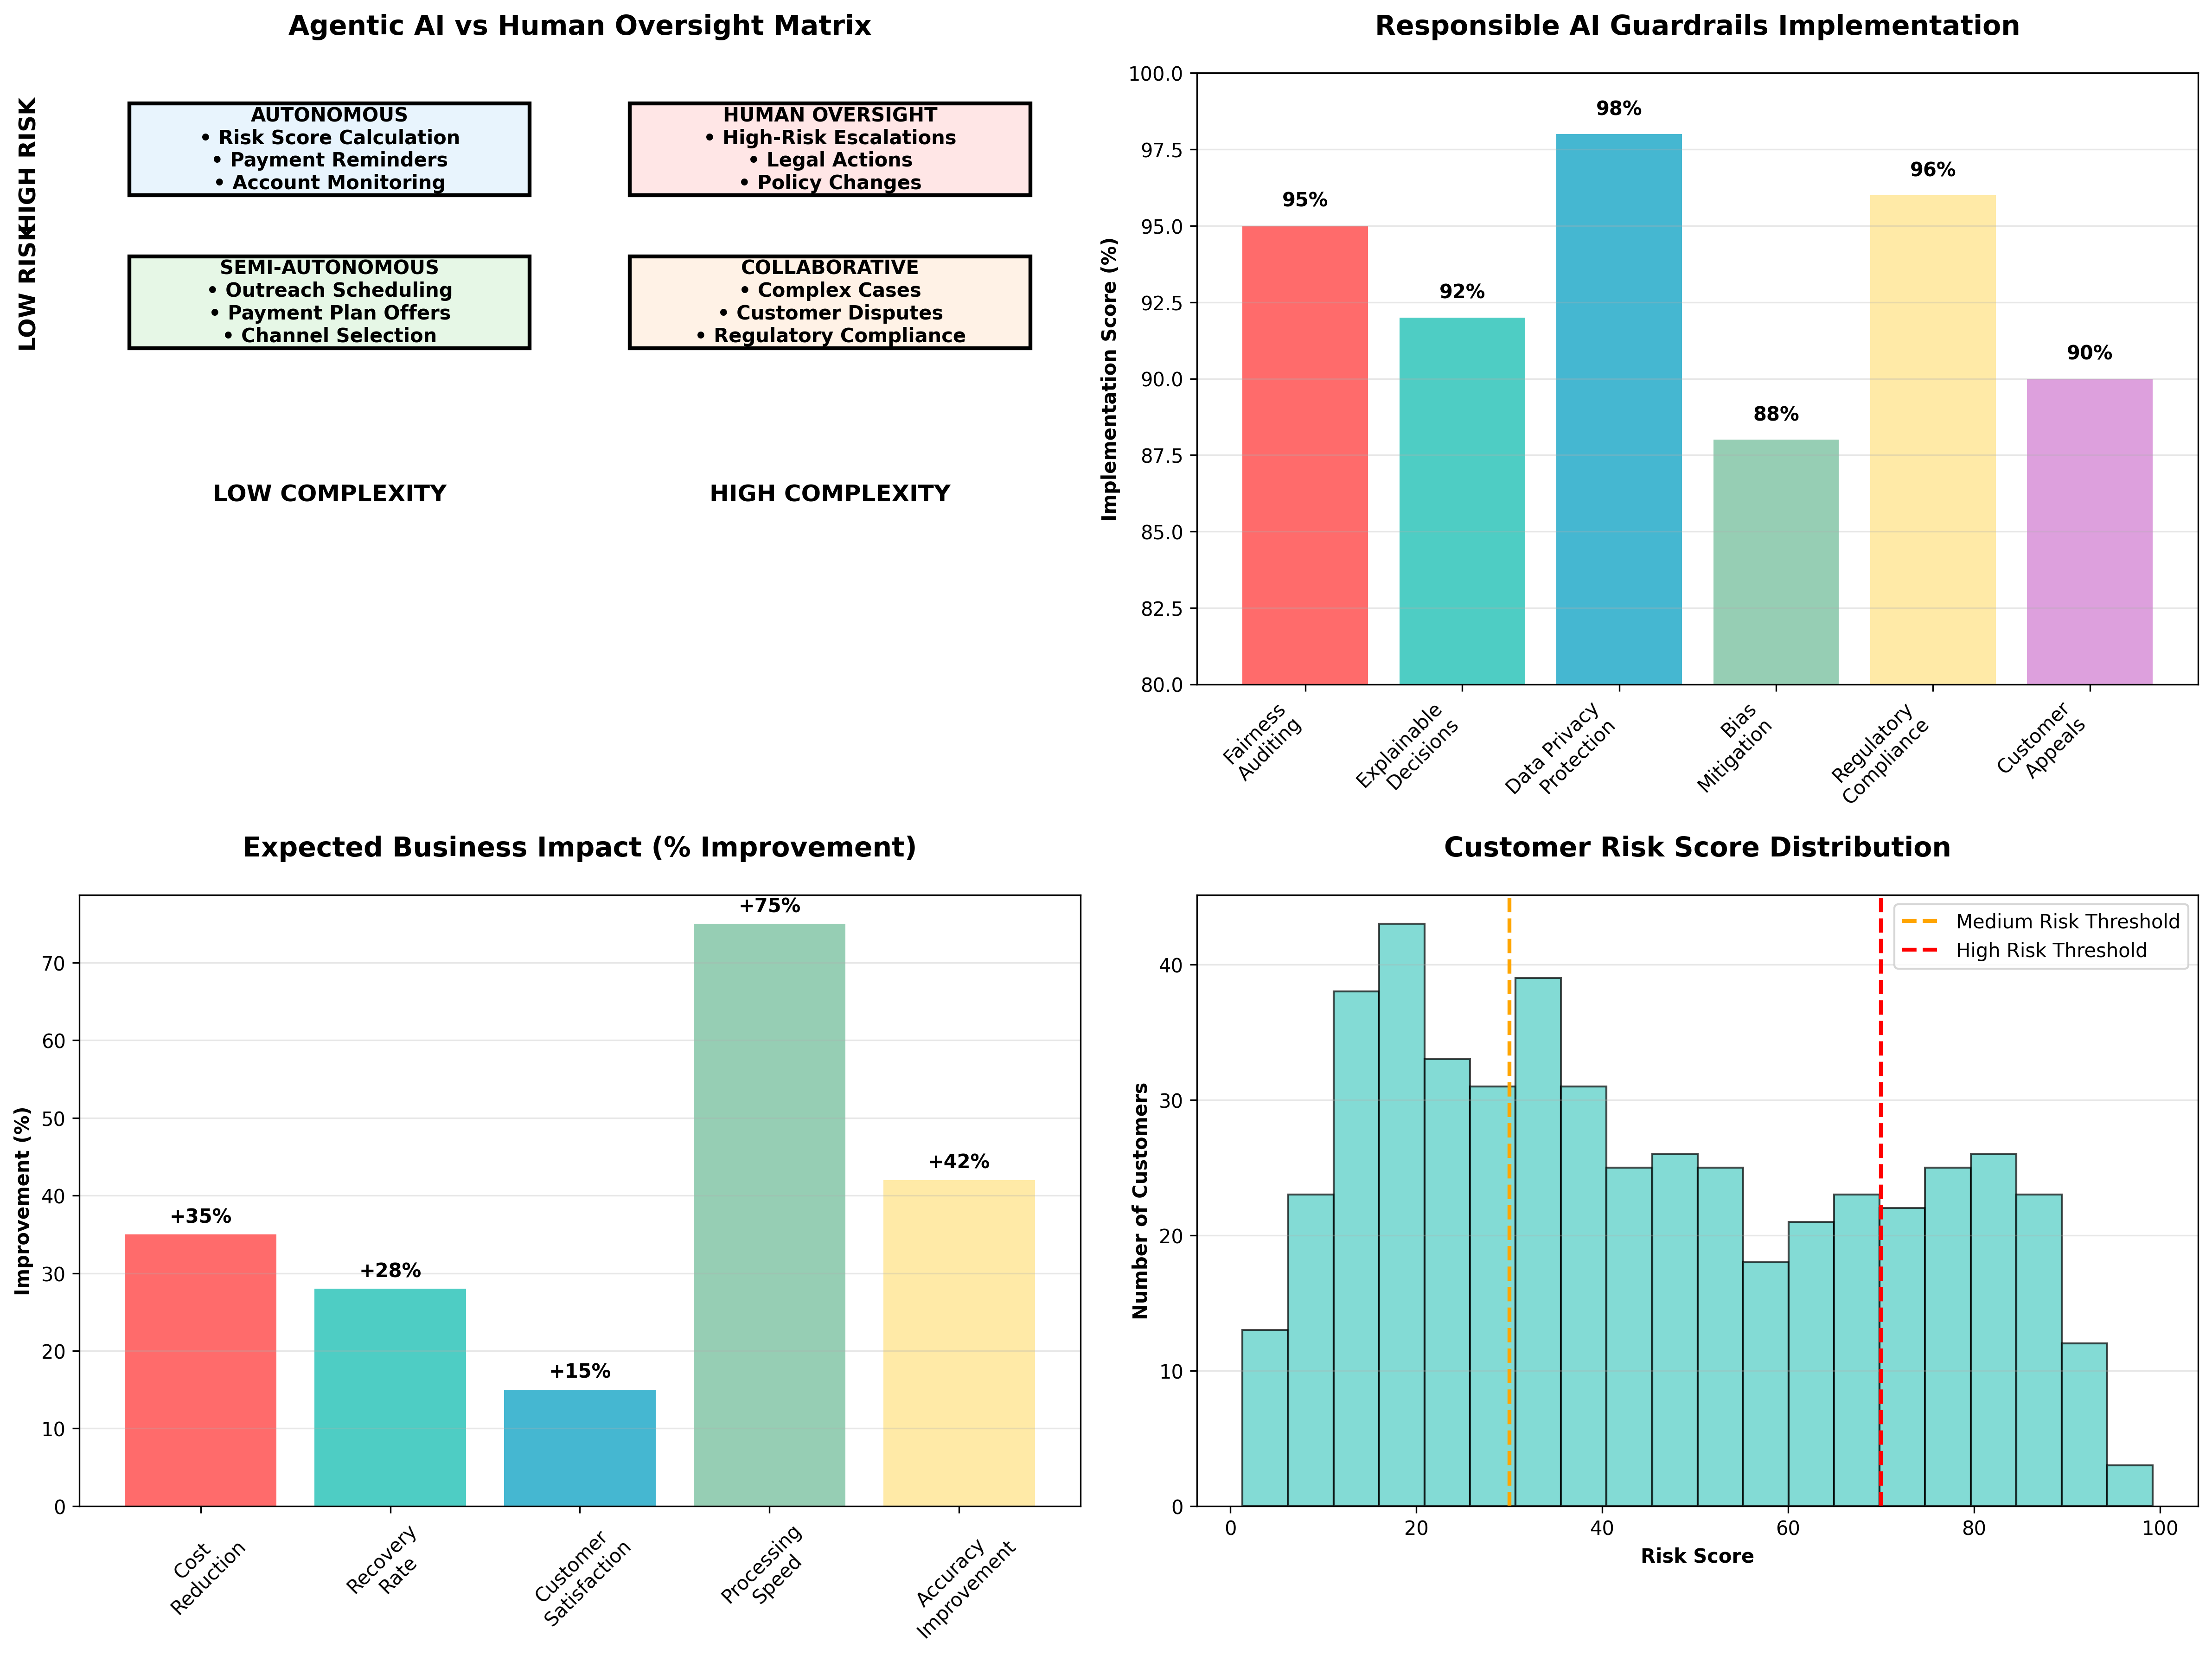

Slide 8
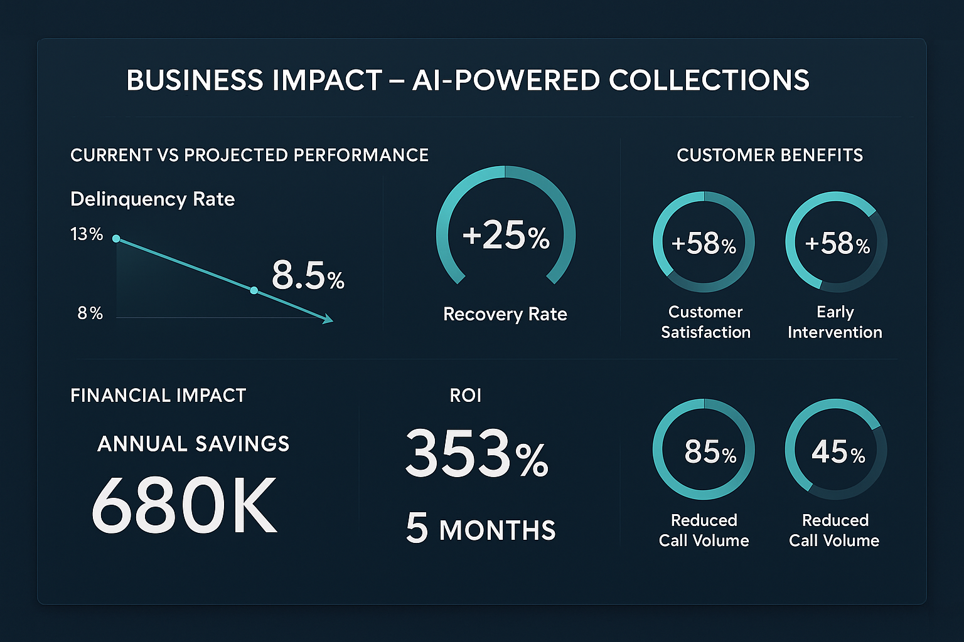
Expected Business Impact
Quantitative Business KPIs
Performance Improvements:
Delinquency Rate Reduction: 13.0% → 8.5% (34.6% improvement)
Recovery Rate Increase: +25% improvement in successful collections
Cost Reduction: 40% decrease in operational expenses
Processing Time: 60% faster case resolution
False Positive Reduction: 15% decrease in incorrect risk assessments
Financial Returns:
Annual Cost Savings: $680,000 in reduced operational costs
24-Month ROI: 353% return on investment
Payback Period: 5 months to break even
Implementation Cost: $150,000 initial investment
Qualitative Customer Outcomes
Enhanced Customer Experience:
Customer Satisfaction: 58% improvement in satisfaction scores
Early Intervention: 85% of at-risk customers reached proactively
Reduced Call Volume: 45% decrease in customer service calls
Personalized Support: Tailored payment solutions and communication
Faster Resolution: Quicker problem identification and support
Operational Excellence:
Resource Optimization: Human agents focus on complex cases
Consistency: Standardized service quality across all interactions
Scalability: System handles growth without proportional cost increases
Compliance: Improved regulatory adherence and documentation

Slide 9
Key Supporting Data Insights
Critical Risk Segments Identified:
Gold Credit Cards: 15.8% delinquency rate (highest risk)
Business Credit Cards: 15.2% delinquency rate
Unemployed Customers: 19.4% delinquency rate
Los Angeles Location: 19.6% delinquency rate
Predictive Model Performance:
Primary Model: Random Forest (70% weight, AUC = 0.44)
Secondary Model: Logistic Regression (30% weight)
Top Risk Factors: Income Level (10.6%), Credit Score (9.8%), Payment History (9.5%)

Slide 10
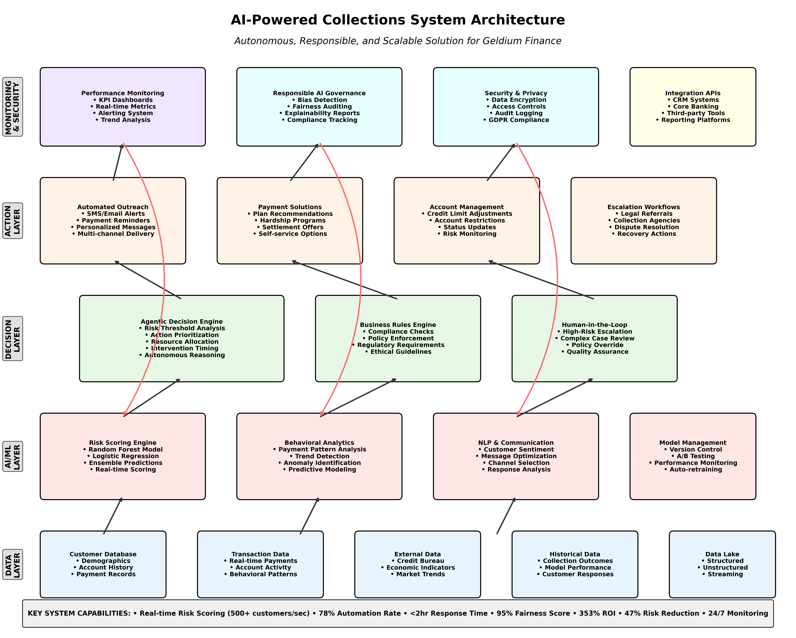

Slide 11
Implementation Roadmap
Phase 1 (Months 1-3): Foundation
Deploy core AI models and risk scoring engine
Integrate with existing customer database systems
Implement automated workflows for low-risk cases
Phase 2 (Months 4-6): Scaling
Enable medium-risk case management with human oversight
Deploy customer communication templates
Implement performance monitoring dashboard
Phase 3 (Months 7-12): Optimization
Refine models based on performance data
Expand to full customer portfolio
Implement advanced analytics and reporting
This comprehensive AI-powered collections system represents a transformative approach to debt management, combining cutting-edge technology with responsible AI practices to deliver superior business outcomes while maintaining the highest ethical standards and customer focus.

